Slide 1
TensorFlow, Theano, Keras, Torch, Caffe

Slide 2
Introduction
TensorFlow | Google Brain, 2015 (rewritten DistBelief)
Theano | University of Montréal, 2009
Keras | François Chollet, 2015 (now at Google)
Torch | Facebook AI Research, Twitter, Google DeepMind
Caffe | Berkeley Vision and Learning Center (BVLC), 2013

Slide 3
Outline
Introduction of each framework
TensorFlow
Theano
Keras
Torch
Caffe
Further comparison
Code + models
Community and documentation
Performance
Model deployment
Extra features
Which framework to choose when ..?

Slide 4
TensorFlow is a software framework for building and deploying machine learning models. (Google solution)
Machine learning is a different approach
than traditional programming.
With traditional programming, we write the program that tells the computer exactly what to do to complete the task
With machine learning, we don't explicitly tell the computer how to do something. Instead we show a training data and the machine learning algorithm uses the training data that produce its own rules to complete the task.

Slide 5
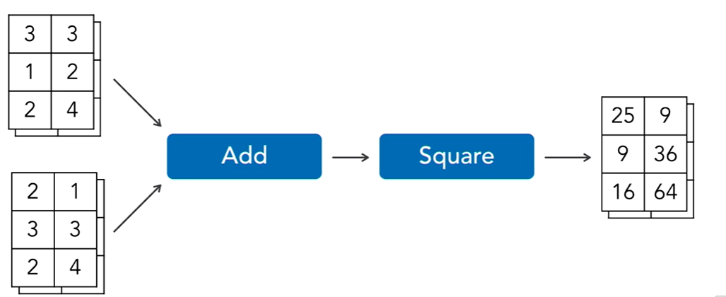
Why?
TensorFlow is a low-level toolkit. It can take quite a few lines of code to build a machine learning model in TensorFlow.
works with large data sets
Tensors(2d)
Keras?
There are wrappers for TensorFlow that simplify common operations. The most popular wrapper for TensorFlow is Keras.
Keras is a high level programming toolkit that makes it easy to build many different types of neural networks with only a few lines of code.
Flow……………………………………..

Slide 6
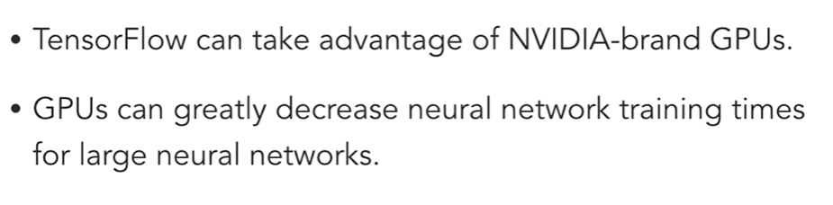
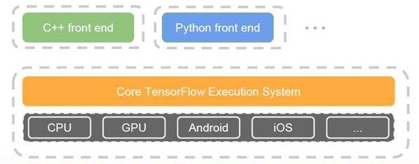
TensorFlow architecture
Low-level core (C++/CUDA)
Simple Python API to define the computational graph
High-level API (TF-Learn, TF-Slim, Keras…)

Slide 7
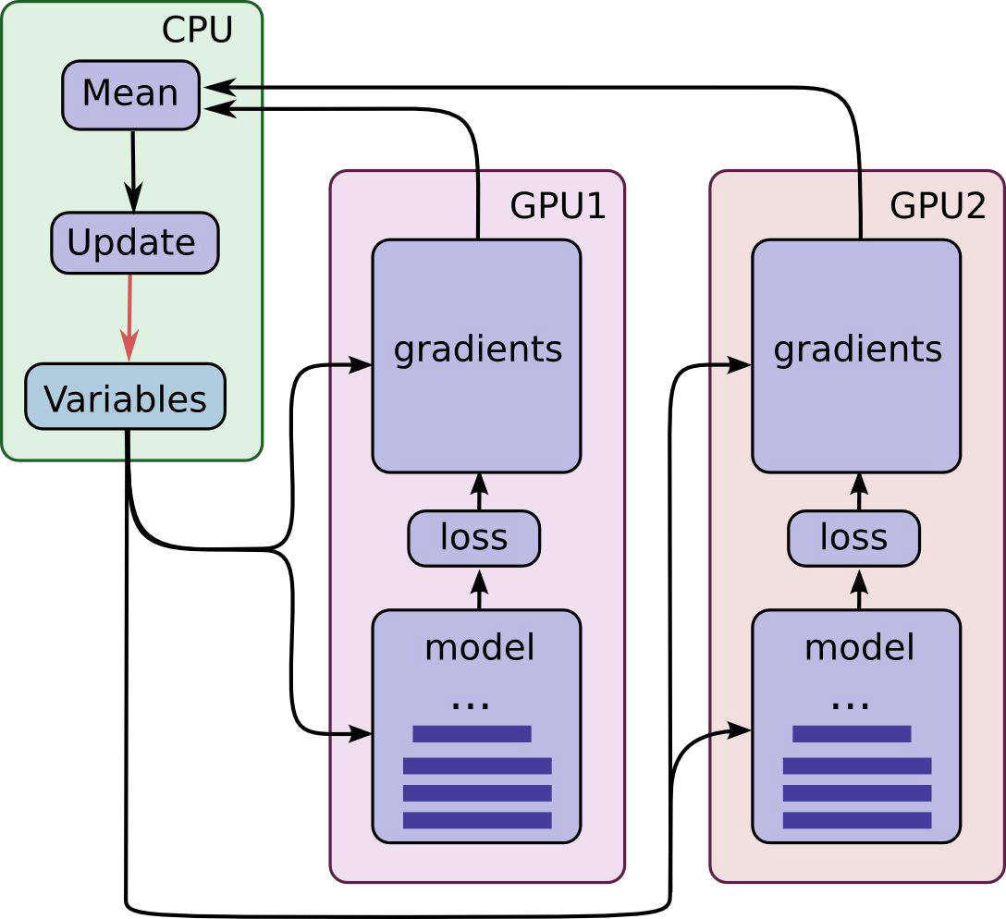
TensorFlow computational graph
auto-differentiation!
easy multi-GPU/multi-node
native C++ multithreading
device-efficient implementation for most ops
whole pipeline in the graph: data loading, preprocessing, prefetching...

Slide 8
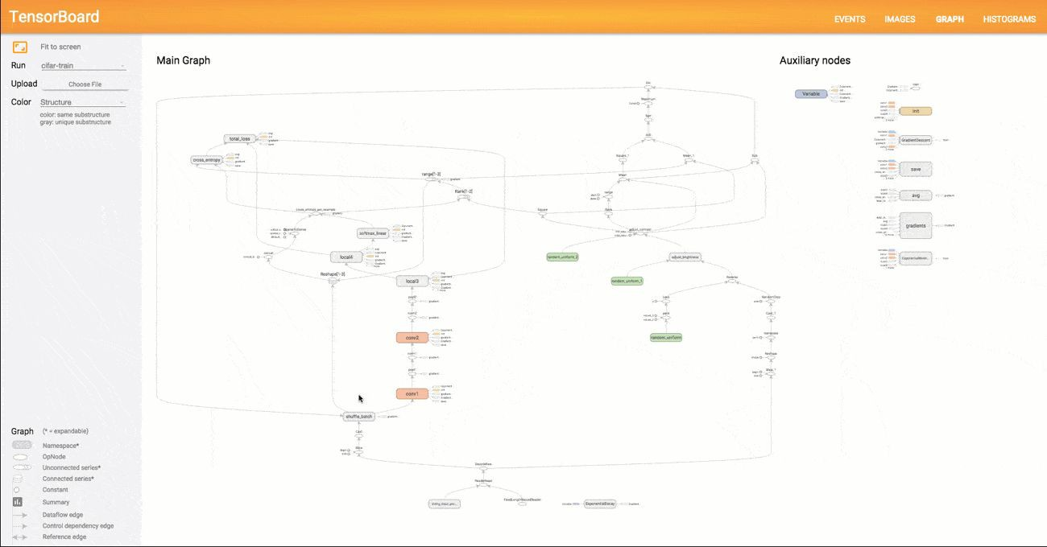
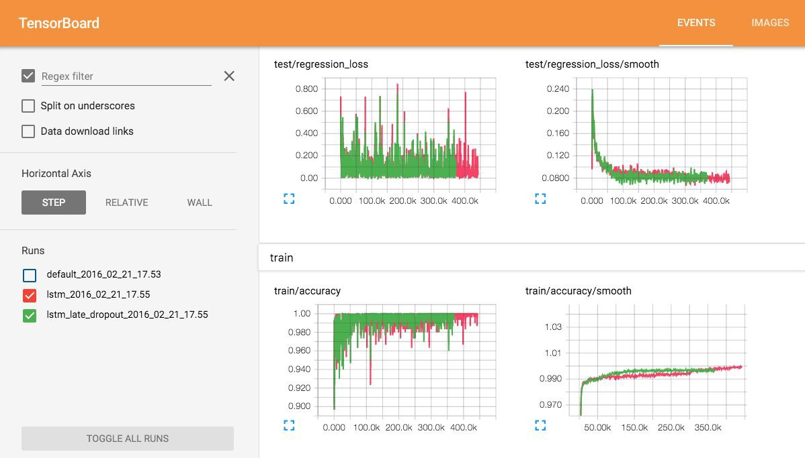
TensorBoard

Slide 9
TensorFlow development
+ bleeding edge (GitHub yay!)
+ division in core and contrib => very quick merging of new hotness
+ a lot of new related API: CRF, BayesFlow, SparseTensor, audio IO, CTC, seq2seq
+ so it can easily handle images, videos, audio, text...
+ if you really need a new native op, you can load a dynamic lib
sometimes contrib stuff disappears or moves
recently introduced bells and whistles are barely documented

Slide 10
Presentation of Theano:
Maintained by Montréal University group.
Pioneered the use of a computational graph.
General machine learning tool -> Use of Lasagne and Keras.
Very popular in the research community, but not elsewhere. Falling behind.

Slide 11
What is it like to start using Theano?
Read tutorials until you no longer can, then keep going.
Once you are convinced that coding in pure Theano is cumbersome, pick up a Deep-learning library to go on top. (Lasagne/Keras).
Make the Theano/Lasagne documentation your home page.

Slide 12
Theano’s flexibility.
Automatic differentiation.
Lasagne is very well conceived, saves a lot of code when trying new things without hurting flexibility.
Most new ideas can be implemented quickly with simple modifications of existing “layers”.

Slide 13
Debugging in Theano: farewell to print debugging.
Main issues:
Compile time of big models can be a huge pain.
Error messages can be cryptic and pop up in the middle of nowhere.
Solutions: Be smart.
Use reduced models (batch size of 1, fewer units per layer, fewer layers).
Write modular code with defensive checks and unit test everything.
Some debugging tools are provided.
No prints.

Slide 14
Keras: strengths
Easy-to-use Python library
It wraps Theano and TensorFlow (it benefits from the advantages of both)
Guiding principles: modularity, minimalism, extensibility, and Python-nativeness
Why python? Easy to learn, powerful libraries (scikit-learn, matplotlib...)
Many easy-to-use tools: real-time data augmentation, callbacks (Tensorboard visualization)
Keras is gaining official Google support

Slide 15
Keras : simplicity
TF example:
kernel = tf.Variable(tf.truncated_normal([3, 3, 64, 64], type=tf.float32,stddev=1e-1), name='weights')
conv = tf.nn.conv2d(self.conv1_1, kernel, [1, 1, 1, 1], padding='SAME')
biases = tf.Variable(tf.constant(0.0, shape=[64], dtype=tf.float32), trainable=True, name='biases')
out = tf.nn.bias_add(conv, biases)
self.conv1_2 = tf.nn.relu(out, name=’block1_conv2’)
Keras:
x = Convolution2D(64, 3, 3, activation='relu', border_mode='same', name='block1_conv2')(x)

Slide 16
Keras: Weakness
Less flexible
No RBM for example
Less projects available online than caffe
Multi-GPU not 100% working

Slide 17

Torch - Framework Architecture
Mixed language :
C / CUDA backend built on common backend libraries
Lua frontend, running on LuaJIT
Why LUA ???
Fast & embeddable
Readable
Very good interface to C
TH / THC Tensor Libraries LuaT
optim torchnet
any lua package...
loadcaffe imgraph
Lu a
cunn autograd nngraph rnn optnet
image
cudnn
cutorch torch nn display
Backend libraries : BLAS, cuDNN, ...
Package installation uses luarocks.

Slide 18
Torch - Getting Started
Learning Lua
...in 15 minutes + gotchas
...if I’m a “book person”
...as I’m coding
Pointers for Torch :
Torch Cheatsheet
Tutorials, official and unofficial packages, demos and code
Torch for Matlab or Numpy users Model Zoo
Awesome-torch
Training on multi-GPUs over ImageNet Distributed training with Torch
Torch
Official presentation at OMLW 14 Official documentation

Slide 19
Torch - Main Strengths (1)
Flexibility
Easy extensibility - at any level, thanks to easy integration with C
Result :
whatever the problem, there is a package.
new generic bricks are often very rapidly implemented by the community and are easy to pull
Imperative (vs declarative)
Typical use case : write a new layer, with GPU implementation :
Implement for CPU nn
Implement for GPU cunn
Test (jacobian and unit testing framework)

Slide 20
Torch - Main Strengths (2)
Flexibility
Readability
Modularity
- mid-level code - as well as high level - is in Lua
Easy to pull someone’s code
Use luarocks to install required packages
- Speed
Very convenient for research.

Slide 21
Torch - Weaknesses
Decent proportion of projects in Torch, but less than Caffe
LuaJIT is not mainstream and does cause integration issues
People hate Lua. But :
Easy to learn
If really, you cannot bring yourself to coding in Lua...

Slide 22
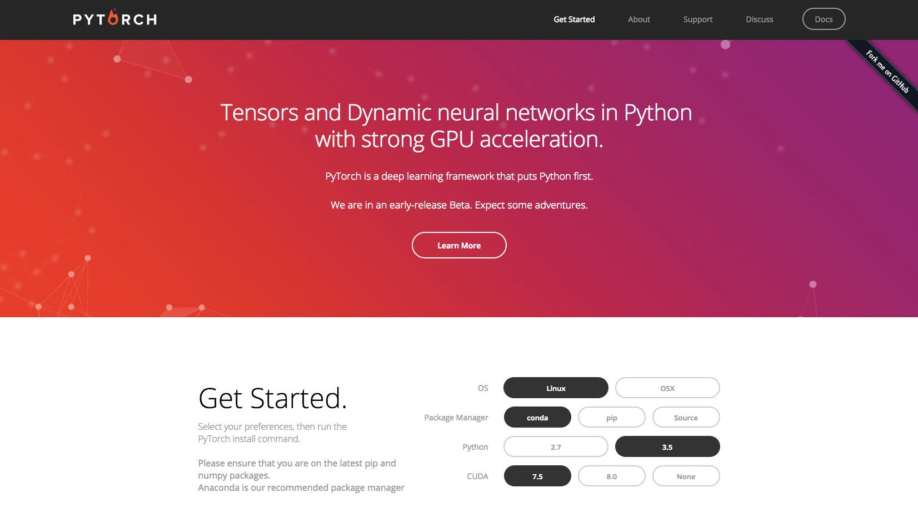
Try it ! :)

Slide 23
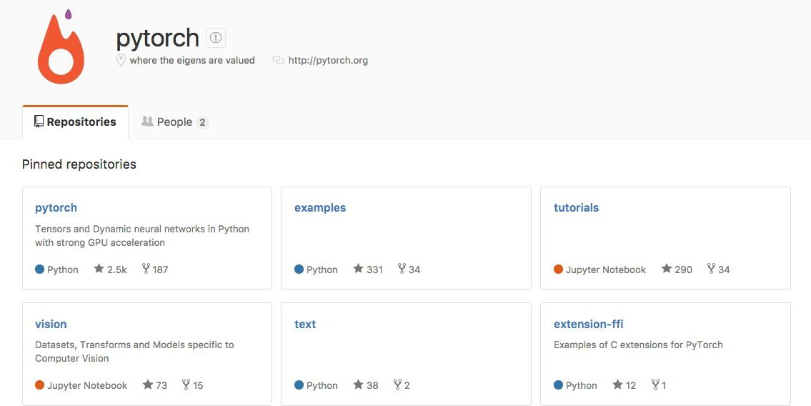

Slide 24









Caffe

Slide 25














Caffe- Flexibility

Slide 26













Caffe- Interface
pycaffe
pycaffe

Slide 27
Caffe- Model examples
layer {
name: "pool1" type: "Pooling"
layer {
name: "conv1"
type: "Convolution"
layer {
name: "loss"
type: "SoftmaxWithLoss"
 | pooling_param { |  | bottom: "data" |  |  | bottom: "fc8"
 | kernel_size: 2 |  | top: "conv1" |  |  | bottom: "label"
 | stride: 2 |  | param { |  |  | top: "loss"
 | pool: MAX |  | lr_mult: 0 |  | }
 | } |  | decay_mult: 0
 | bottom: "conv1" |  | }
 | top: "pool1" |  | convolution_param | {
} |  |  | num_output: 64
 |  |  | kernel_size: 3
 |  |  | pad: 1
 |  |  | }
 |  | }

Slide 28
Caffe- Solver
creation of the training network for learning and test network(s) for evaluation
iterative optimization by calling forward / backward and parameter updating
(periodical) evaluation of the test networks
snapshotting of the model and solver state throughout the optimization

Slide 29
Caffe- Solver example
base_lr: 0.01
# begin training at a learning rate of 0.01 = 1e-2
lr_policy: "step"
# learning rate policy: drop the learning rate in "steps" # by a factor of gamma every stepsize iterations
gamma: 0.1
# drop the learning rate by a factor of 10
# (i.e., multiply it by a factor of gamma = 0.1)
stepsize: 100000
# drop the learning rate every 100K iterations
max_iter: 350000
# train for 350K iterations total

Slide 30















Caffe- Architecture

Slide 31






Caffe- Extra

Slide 32

















Caffe- Extra

Slide 33
Further comparison

Slide 34























Code + models

Slide 35
Community and Documentation
Community : (Github, groups, discussions...)
Caffe has the largest community
TensorFlow’s is already large and growing.
Keras’ community is growing, while Theano’s and Lasagne’s are declining
Documentation
Great documentation for Theano, Lasagne, Keras and Torch
Most recent API is not documented for TensorFlow. Tutorials are often outdated.

Slide 36























Performance

Slide 37










Model deployment

Slide 38











Extra features
…

Slide 39
Which framework to choose when...

Slide 40
Which framework to choose when ..?
You are a PhD student on DL itself?
You want to use DL only to get features?
You work in industry?
You started your 2 month internship?
You want to give practise works to your students?
You are curious about deep learning?
You don’t even know python?

Slide 41
Which framework to choose when ..?
You are a PhD student on DL itself: TensorFlow, Theano, Torch
You want to use DL only to get features: Keras, Caffe
You work in industry: TensorFlow, Caffe
You started your 2 month internship: Keras, Caffe
You want to give practise works to your students: Keras, Caffe
You are curious about deep learning: Caffe
You don’t even know python: Keras, Torch

Slide 42
Docker
Docker is a virtualization solution (similar to virtual machine). You can download container (or “image”) containing all the frameworks you need.
Why is is useful for DL?
Installing all the DL frameworks takes time, so download a docker image instead.
You are sure to have the same running environment on two different machines
You cannot be root on the cluster.
Don’t share the code only. Share your docker image also.

